Slide 1
Notes:
If boorun hangs with tomcat running, port 8080 will be hung and no more runs since 8080 already bound
Run from command line
C:%> netstat –ano // show PID of process listening on port 80.
C:%> taskkill /F /PID XXX // kill the task
SpringBoot: AdvSpring/Adv_SpringBoot_WebDemo: Example at end of section,
Comes up, but doesn’t find Javascript when returning from MVC Controller GET method
Find tutorial on SpringBoot web using javascript
Student guild, 4-13a and 4-13e
In Spring 1.3 spring.view.prefix and spring.view.suffic changed to spring.mvc.view.prefix and suffix

Slide 2
Advanced Spring
Extra Material
Notes:
Setup
Name on board
Websites (UPDATE)
REST dissertation: Chapter 5: http://www.ics.uci.edu/~fielding/pubs/dissertation/rest_arch_style.htm
Fowler on REST Maturity Model: http://martinfowler.com/articles/richardsonMaturityModel.html
REST to HTTP method described by Spring at : https://spring.io/understanding/REST
Spring Remoting and Web Services : http://docs.spring.io/spring/docs/3.1.x/spring-framework-reference/html/remoting.html#rest-message-c

Slide 3

Core Spring Lab Manual and Presentation
You should have an email
From Clif J. Johnson <cjohnson@protechtraining.com>
Thursday Feb 9 at 8:52 AM
Includes a link to download a zip file containing
Student Manual
Lab Manual
Now would be a good time to
Find the email
Download the documents
Open them up
You will need them Both for the Labs!
Notes:
Page 1 of lab manual should have heading
Lab 1: Setting Up the Demo Project

Slide 4
Virtual Lab Access
To Access your Virtual Lab Environment, go to
https://labs.protechtraining.com
Bookmark This Page!
Count off from 121 to 133
Remember Your Number!
Log In Now to access your own personal Virtual Environment!
UserID : PTACCESSXXX Where XXX is your number
Password : Pa$$w0rd That’s a Zero, not and ‘O’
Your Host Computer: COMPUTERXXX Where XXX is your number
Access Code: Pa$$w0rd That’s a Zero, not and ‘O’

Slide 5
Maximizing Virtual Lab Window
When connecting to your labs,
Require HTML 5 browser on your local computer
Put Browser (prior to logging in) in either
Maximized window
Full Screen Mode (preferred)
Once you log in, your resolution will be locked until you disconnect from your remote lab and reconnect at a different screen/window size.
Notes:
Maximize good because resolution probably isn’t what you’re use to on your laptop, so hard to see everything….
Full screen, or maximized?
ProTech likes Full screen…

Slide 6
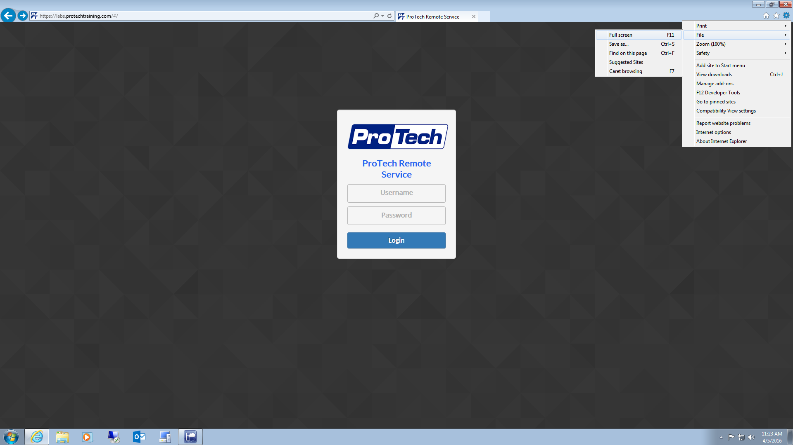
To avoid confusion with multiple task & tile bars, it is advisable to place your browser into Full Screen mode. Steps may be different based on which browser you are using. Most browsers can be toggled in and out of Full Screen mode by hitting the F11 key.
Once in Full-Screen Mode, your taskbar will disappear and your browser title bar will auto hide.
Notes:
Full screen hides your laptop taskbar,
So don’t confuse it with the virtual lab environment taskbar
Go ahead and try it by hitting the F11 key

Slide 7
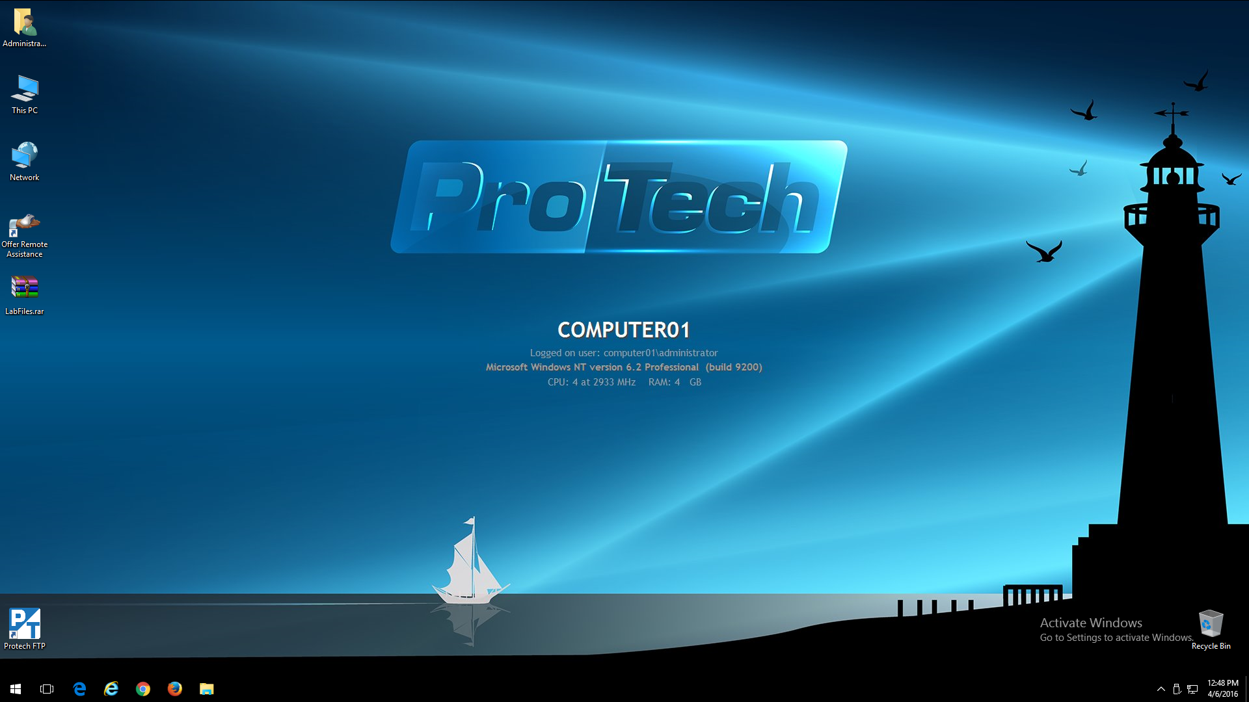
ProTech Remote Lab File Retrieval
Create a compressed archive of your lab files and place on your desktop (alphanumeric characters only, no spaces, 500MB MAX file size).
Select the ProTech FTP icon from the desktop. If the icon is not present, then this feature is not available.
Notes:
Here is the screen you’ll see
Please BE SURE your number is the one in the middle of the screen
Or you will be using someone else's environment
You are going to be doing labs all day
And will want to take your labs home with you at the end of the day
These are the ways ProTech gives you to move your files
You can also use your own cloud dropBox, iCloud, GoogleDrive, etc.
Or just zip and email it to yourself
Highly suggest you install
7_zip
Notepad++

Slide 8
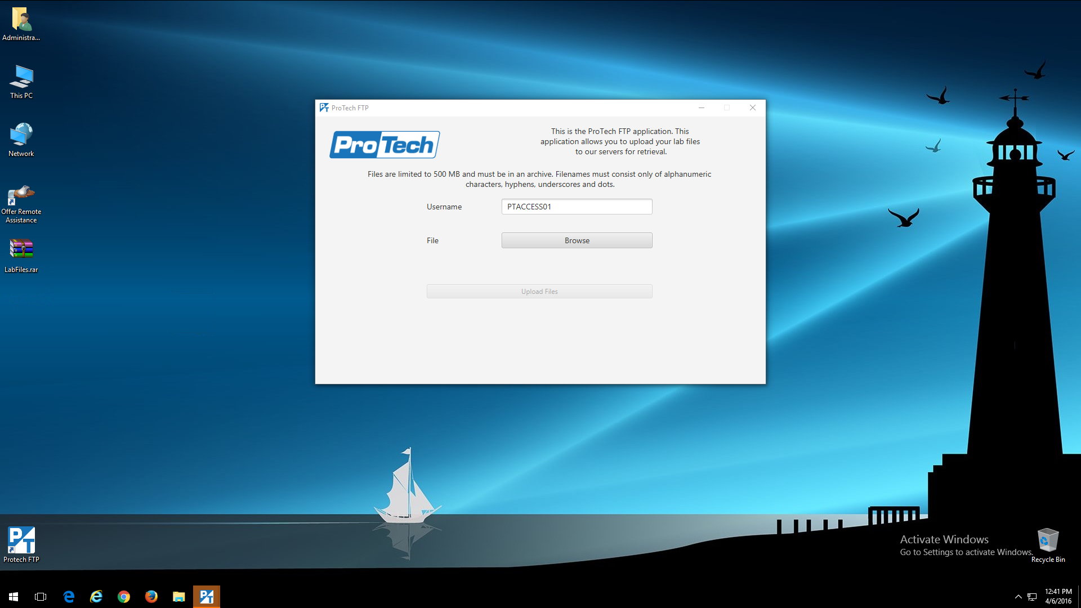
Enter your PTACCESS## or PTACCESS###
Click Browse
Notes:
If you use the ProTech FTP App you’ll use your PTAccessXXX user name and follow what it says
You will be uploading a ZIP archive to the ProTech server

Slide 9
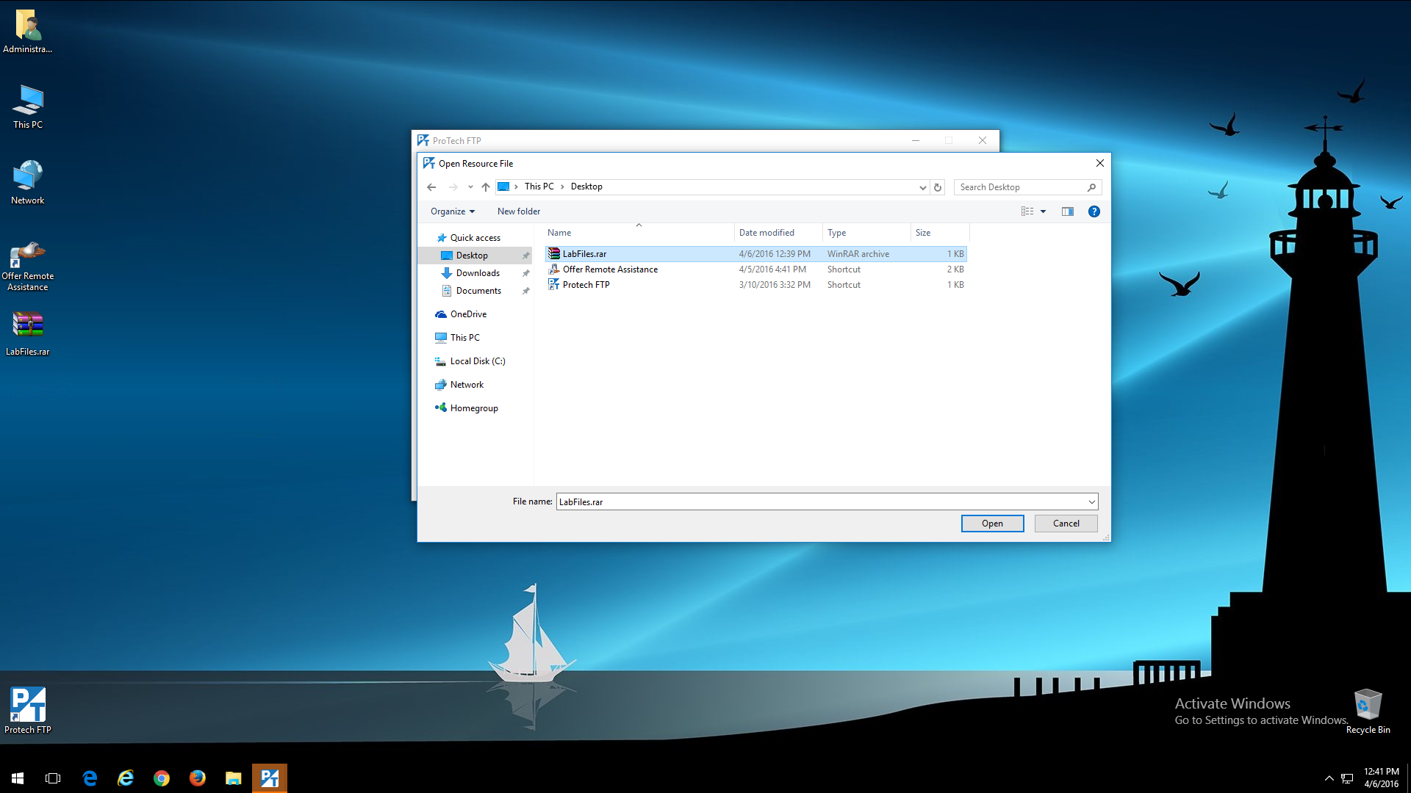
Navigate to the location of your lab file archive and click Open

Slide 10

Click Upload Files

Slide 11
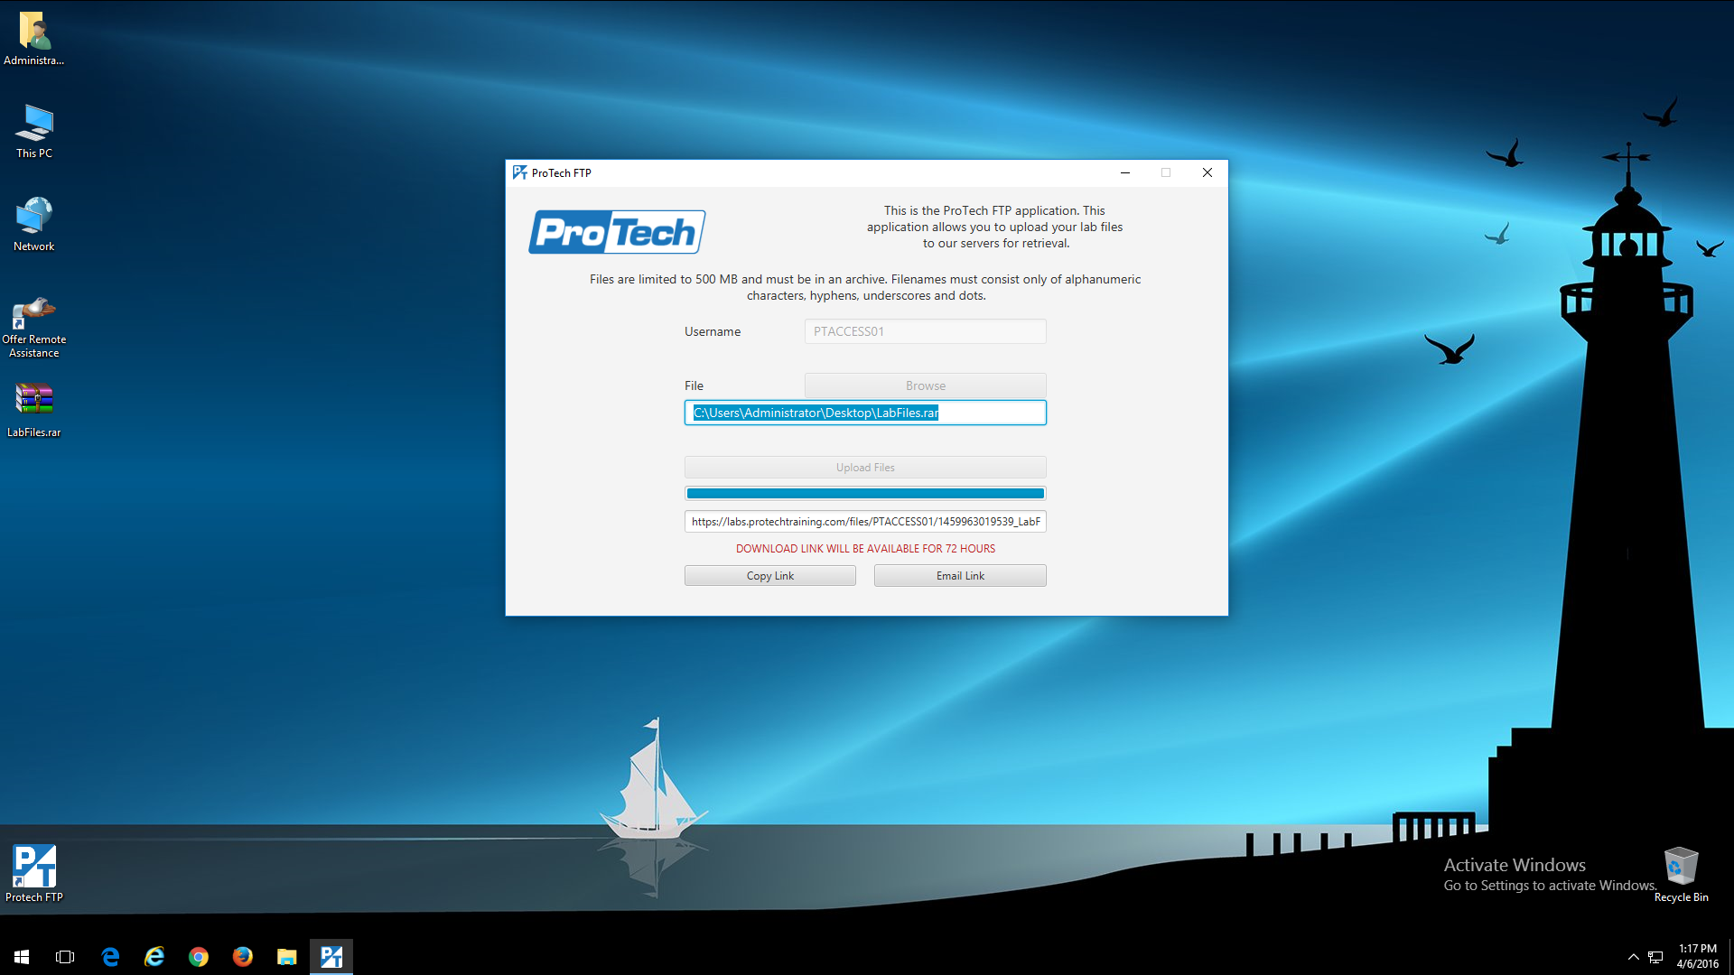
A link will be generated based on the PTACCESS ID. You can send this link to an email address, or copy and paste it using the HTML5 control panel clipboard.
Copy to HTML 5 clipboard
Send link in an email

Slide 12

Enter your email address. Personal email addresses are preferred to avoid corporate email security filters.
Notes:
Your email with the link will tell you how many days you have to retrieve your zip file from the ProTech server

Slide 13
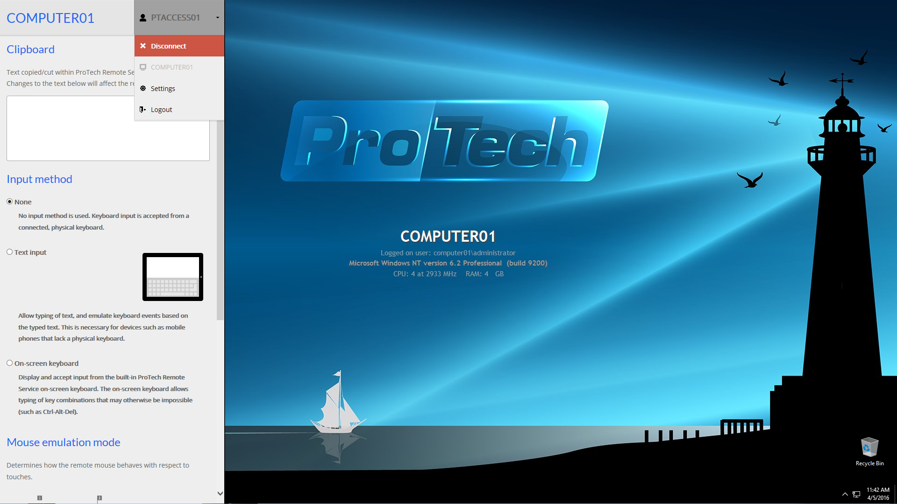
Drop down your PTACCESS ID and choose Disconnect
To display an admin panel on the left side of your screen.
Press <Ctrl><Alt><Shift> all from the left side of your keyboard.
Notes:
Ctrl-Alt-Shift from left side of keyboard
Opens up the admin panel

Slide 14
Lab Installation Locations
Base Directory: C:\Users\Administrator\
Target | Installation Directory | Access
Spring | $(Base Directory)\java\spring-1.3.1.RELEASE $(Base Directory)\java\spring-xd-1.3.1.RELEASE | File Explorer
Eclipse | $(Base Directory)\java\eclipse | Desktop Shortcut
Tomcat | $(Base Directory)\advspring\tomcat | File Explorer
Lab folders | $(Base Directory)\advspring\starters $(Base Directory)\advspring\solutions $(Base Directory)\advspring\workspace | File Explorer
LabGuide | $(Base Directory)\advspring\pdf | File Explorer
Notes:
Show:
Getting around
Shortcuts to Admin account holding tools and advspring class
Shortcut to advspring class
Show different folders in table
Getting your work off the VM by end of class
Protech FTP
How to archive
Chrome: have internet with no filtering… be good
Means can zip up your labs and send them to you Personal cloud to save your work
Probably can’t send code to your CapitalOne account

Slide 15
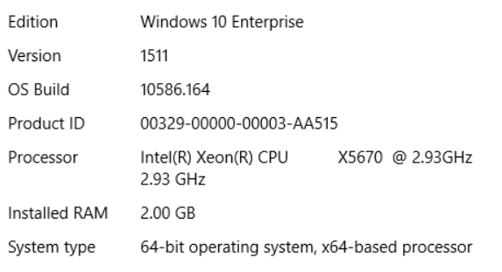
Your Tools
Your VM will be wiped out after class
So feel free to install your favorite productivity tools
7-zip
Notepadd++
Git (To upload to your GitHub repository!)
Etc…
Your VM System

Slide 16
The Application Context
More advanced than a simple BeanFactory
Adds enterprise-specific features
Derived from AbstractApplicationContext
Each child adds different capabilities
Lab01 using 2 different AbstractApplicationContext variations
FileSystemXmlApplicationContext("src/main/java/spring.xml");
Spring XML Configuration
Spring Annotation Configuration
AnnotationConfigApplicationContext (FrequentFlierConfig.class);
Spring Java Configuration
Notes:
Two MessageSource implementations:
ResourceBundleMessageSource
StaticMessageSource (rarely used…)

Slide 17
Lab 1 Introduction to Spring Boot
45 minutes
GotCha’s
Gradel is NOT installed, so do a instructions say and use gradlew instead….
Do work in : cd \Users\Administrator\advspring\workspace\lab01
No issues in lab, but try to learn the springBoot CLI!
You’ll be happy you did later….
You’ll be using WordPad to edit your build.gradle files for every lab from now on
Unless you downloaded NotePad++… ;~)
Notes:
DeBrief:
Part 1: Basics
2 ways to run the application, Gradle bootRun, or by running DemoApplication.java in Eclipse
Changes to DemoApplicaiton to repress banner,
Could be a good place to put other directives to the SpringApplication
Notice Controller autowire is looking for an interface called Shipping,
not the concrete class ShippingImpl
Code
Controller: com.example.service.ShippingController look at POST method submitForm(model)
Attributes added to model
matches Thymeleaf expression is src/main/resources/templates/shippingResults.html
com.example.service.ShippingController
@RequestMapping(“/shipping”)
matches post action in src/main/resources/templates/shipping.html

Slide 18
Controlling Spring Boot Auto-Configuration
Discover What auto-configuration is being applied
Start your application with the --debug switch.
Enables debug logs to write an auto-configuration report to the console
To Disable Specific auto-configuration
Use the @enableAutoConfiguration “exclude” attribute
Or use the spring.autoconfigure.exclude property
@Configuration
@EnableAutoConfiguration(exclude={DataSourceAutoConfiguration.class})
public class DemoApplication {
Notes:
use the exclude attribute of @EnableAutoConfiguration to disable them.

Slide 19
Lab 2 More Spring Boot : GotCha’s
90-120 minutes
Part 1
_6. b. Gives wrong section title
Specifies: runtime - Runtime classpath for source set 'main’
Instead Use: runtime - Runtime dependencies for source set 'main'.
Part 3 _2.
-1.f. Starter file does not contain the SQL. Most is in
Use schema.sql from lab02p2 and add the last INSERT statement
_2. Copying lap02p2 with Windows Explorer doesn’t change Eclipse to a new project. After copying,
Edit build.gradle to change baseName to lab02p3
At the command prompt in the new lab02p3 directory enter gradlew cleanEclipse, to clean all Eclipse file.
Then gradlew eclipse, to regenerate Eclipse file
Part 4 _1. Follow instructions for Part 3 after copy project to reset it before importing into Eclipse
Notes:
DeBrief:
Versions Part 1 _6 b.
org.springframework:spring-jdbc:
org.springframework:spring-jdbc:4.2.4.RELEASE
com.fasterxml.jackson.core:jackson-databind:
com.fasterxml.jackson.core:jackson-databind:2.6.4
com.h2database:h2
com.h2database:h2: -> 1.4.190
org.yaml:snakeyaml:
org.yaml:snakeyaml:1.16
_7 d. if you only exclude org.hibernate from one of spring-boot-starter-web and thymeleaf,
It will not be removed
Even though spring-boot-starter-web is under thymeleaf.
Need to exclude it from both

Slide 20
Day 1: What Have We Learned?
Spring Core Review
What is the Spring Framework?
Spring Architecture
Introduction to Gradle
Advantages
Groovy and Build Files
Tasks, Plugins, and Dependency Management
Introduction to Spring Boot
What is Spring Boot?
Starter Projects
Autoconfiguration
Building and Running
Additional Spring Boot Topics
Starter Dependencies
Auto Configuration
Deploying a WAR
Feedback:
Class Pace:
Too fast,
Too slow
Just Right?
Content:
What did you enjoy the most
Anything Else you want to learn
Delivery:
What did you like, I’ll do more!
What can be improved?
Notes:
Setup
Websites:
Spring Boot Website: http://projects.spring.io/spring-boot
Spring Boot Initialzr: http://start.spring.io
Gradle Java Plugin: https://docs.gradle.org/current/userguide/java_plugin.html

Slide 21
Introduction to Day 2!
Day 1 topics
Today’s topics
Spring Core Review
What is the Spring Framework?
Spring Architecture
Introduction to Gradle
Advantages
Groovy and Build Files
Tasks, Plugins, and Dependency Management
Introduction to Spring Boot
What is Spring Boot?
Starter Projects
Autoconfiguration
Building and Running
Additional Spring Boot Topics
Starter Dependencies
Auto Configuration
Deploying a WAR
Spring Remoting and JMS
JmsTemplate
Sending and Receiving Messages
Introduction to Spring Batch
Spring Batch Application Concepts
Structure and Configuration
Enterprise Integration Patterns
Overview
EIP Categories
Spring Integration
Components, Channel, and Service Activation
Messaging Gateway
Spring Integration Messages and Channels
Direct, Publish Subscribe, and Queue Channels

Slide 22
Lab 3 Spring and JMS
60 minutes
GotCha’s
_3. b. Not the buildscript { repositories {…}}
Put in the repository list in lower half of build.gradle file
Notes:
DeBrief:
Tomcat Jasper is the embedded JSP engine

Slide 23
Lab 4 Spring Batch
120 minutes
GotCha’s
Part 1 _7. a. for Job import use interface
org.springframework.batch.core.Job
Part 2
_2. don’t forget to change the baseName in build.gradle
_14. a. a. for Job import use interface
org.springframework.batch.core.Job
Part 3: Most of the methods you need to write are from the implemented interfaces
Use Source -> Override/Implement Methods…
Notes:
DeBrief:
Com.exampleBatchConfiguration:
The @EnableBatchProcessing annotation
enables Spring Batch and
sets up a base configuration, including
a JobRepository,
JobLauncher,
JobRegistry and
job and step factories.
You can then autowire these into your program.
compile ('commons-dbcp:commons-dbcp:1.4')
Apache Commons Database Connection Pooling

Slide 24
Lab 5: Introduction to Spring Integration
40 minutes
GotCha’s
None! Have Fun!
Notes:
DeBrief:
Tomcat Jasper is the embedded JSP engine
Both part 1 and part 2 are in the same project in different packages
So have 2 main() methods, and can’t run from command line
Just run from Eclipse

Slide 25
Lab 6: Messages and Channels
45-60 minutes
GotCha’s
Part2: Publish Subscribe code is not in the Solutions
But it’s not bad,
Use either the MethodInvokingMessageHandler or the ServiceActivatingHandler ServiceActivator for the subscribers
Don’t forget to stop the HSQLDB Database and GUI when you are done!
Notes:
DeBrief:
Tomcat Jasper is the embedded JSP engine

Slide 26
Day 2: What Have We Learned?
Spring Core Review
What is the Spring Framework?
Spring Architecture
Introduction to Gradle
Advantages
Groovy and Build Files
Tasks, Plugins, and Dependency Management
Introduction to Spring Boot
What is Spring Boot?
Starter Projects
Autoconfiguration
Building and Running
Additional Spring Boot Topics
Starter Dependencies
Auto Configuration
Deploying a WAR
Annotations
Spring Remoting and JMS
JmsTemplate
Sending and Receiving Messages
Introduction to Spring Batch
Spring Batch Application Concepts
Structure and Configuration
Enterprise Integration Patterns
Overview
EIP Categories
Spring Integration
Components, Channel, and Service Activation
Messaging Gateway
Spring Integration Messages and Channels
Direct, Publish Subscribe, and Queue Channels
Feedback:
Class Pace:
Too fast,
Too slow
Just Right?
Content:
What did you enjoy the most
Anything Else you want to learn
Delivery:
What did you like, I’ll do more!
What can be improved?

Slide 27
Introduction to Day 3
Spring Core Review
What is the Spring Framework?
Spring Architecture
Introduction to Gradle
Advantages
Groovy and Build Files
Tasks, Plugins, and Dependency Management
Introduction to Spring Boot
What is Spring Boot?
Starter Projects
Autoconfiguration
Building and Running
Additional Spring Boot Topics
Starter Dependencies
Auto Configuration
Deploying a WAR
Spring Remoting and JMS
JmsTemplate
Sending and Receiving Messages
Introduction to Spring Batch
Spring Batch Application Concepts
Structure and Configuration
Enterprise Integration Patterns
Overview
EIP Categories
Spring Integration
Components, Channel, and Service Activation
Messaging Gateway
Spring Integration Messages and Channels
Direct, Publish Subscribe, and Queue Channels
Integration Endpoints
Messaging, Inbound, and Outbound Endpoints
Gateways and Routers
Splitters, Aggregators, Filters, and Transformers
Introduction to Hadoop
HDFS
MapReduce
YARN
Introduction to Spring XD
Streams, Sources, and Sinks
Processors and Tags
Tools
Spring XD Modules
Sources, Sinks, and Processors
Taps, Counters, and Guages
XD Jobs
Notes:
SETUP: Have open in browser
Video:Martin Fowler at GO 2012 overview of NoSQL databases
Start at 9:36
End when done with aggregate types of databases
https://www.youtube.com/watch?v=qI_g07C_Q5I
Couchbase Definitions of the editions are at:
http://developer.couchbase.com/documentation/server/4.5/introduction/editions.html
For a comparison of the two editions, see
http://developer.couchbase.com/documentation/server/4.5/introduction/editions.html
Couchbase JavaDoc:
http://docs.couchbase.com/sdk-api/couchbase-java-client-2.3.4/

Slide 28
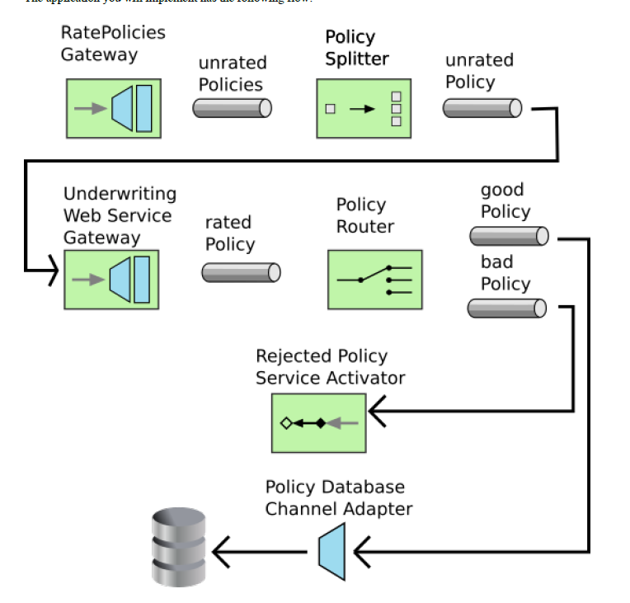
Lab07 Message Flow

Slide 29
Lab 7: Endpoints
90 minutes
GotCha’s
Part 1,
-1. b. command to start DB is slightly different than last time
_1. f. Lab07 starters does not contain the SQL, just type it in
Part2,
_1. c. Be sure to create a “file”, not a “class”.
Filename package.info is not a valid class name.
Don’t forget to stop the HSQLDB Database and GUI when you are done!
Notes:
DeBrief:
Tomcat Jasper is the embedded JSP engine

Slide 30
Lab 8: Introduction to Spring XD
25 minutes
GotCha’s
Part1 _3. To avoid line wrap in the Spring XD cmd prompt
Open the properties on the command windows
Set Layout->Screen Buffer Size->Width to 190
Otherwise: None! Have Fun! :~D
Notes:
DeBrief:
Tomcat Jasper is the embedded JSP engine

Slide 31
Lab 9: XD Modules
15 minutes
40 minutes with Challenge!
GotCha’s
Writing the stream cmd in a text editor and copy it into the XD Shell window
Makes it easier to correct typos, since cmd will be long enough to wrap!
Part 1: _1. b. Command to start database is slightly different than in lab07
Part1 _2. As in the lab08, to avoid line wrap in the Spring XD cmd prompt
Open the properties on the command windows
Set Layout->Screen Buffer Size->Width to 190
_7. File is in C:\tmp\xd\output
Sometimes the cmd window hangs when destroying the stream
May need to start a new Spring XD
Use the GUI to destroy the stream to avoid this
Don’t forget to stop the HSQLDB Database and GUI when you are done!
Notes:
DeBrief:
xd:>stream create --name processAccount
--definition
"jdbc --url=jdbc:hsqldb:hsql://localhost:9002/ --query='select * from account'
--username=sa --fixedDelay=100 |
filter --expression='payload.balance > 0.00 && payload.open == TRUE‘
| file --suffix=log" –deploy
xd:>stream create --name processAccount --definition "jdbc --url=jdbc:hsqldb:hsql://localhost:9002/ --query='select * from account' --update='update account set newrow=false' --username=s| f
ilter --expression='payload.newrow == TRUE' | file --suffix=log" --deploy

Slide 32
Lab 9: XD Modules Filters
Use JDB, Filter out 0 balance accounts and closed accounts
xd:>stream create --name processAccount
--definition
"jdbc --url=jdbc:hsqldb:hsql://localhost:9002/ --query='select * from account'
--username=sa --fixedDelay=100
| filter --expression='payload.balance > 0.00 && payload.open == TRUE‘
| file --suffix=log" –deploy
xd:>stream create --name processAccount --definition "jdbc --url=jdbc:hsqldb:hsql://localhost:9002/ --query='select * from account' --update='update account set newrow=false' --username=s| filter --expression='payload.newrow == TRUE' | file --suffix=log" --deploy
Notes:
Spring XD Installation directory: /Users/username/java/spring-xd-1.3.0.RELEASE
Xd/bin/xd-singlenode.bat
Shell/bin/xd-shell.bat
Start the Spring XD Web GUID : http://localhost:9393/admin-ui
Log file in c:/tmp/xd/output

Slide 33
Lab 9: XD Modules Challenge
Use JDB, Filter on New Rows, Update New Row column to True, print output to log file
xd:>stream create --name processAccount
--definition
“jdbc --url=jdbc:hsqldb:hsql://localhost:9002/ --query='select * from account‘
--update='update account set newrow=false' --username=s
| filter --expression='payload.newrow == TRUE'
| file --suffix=log" --deploy

Slide 34
What Have We Learned?
Spring Core Review
What is the Spring Framework?
Spring Architecture
Introduction to Gradle
Advantages
Groovy and Build Files
Tasks, Plugins, and Dependency Management
Introduction to Spring Boot
What is Spring Boot?
Starter Projects
Autoconfiguration
Building and Running
Additional Spring Boot Topics
Starter Dependencies
Auto Configuration
Deploying a WAR
Spring Remoting and JMS
JmsTemplate
Sending and Receiving Messages
Introduction to Spring Batch
Spring Batch Application Concepts
Structure and Configuration
Enterprise Integration Patterns
Overview
EIP Categories
Spring Integration
Components, Channel, and Service Activation
Messaging Gateway
Spring Integration Messages and Channels
Direct, Publish Subscribe, and Queue Channels
Integration Endpoints
Messaging, Inbound, and Outbound Endpoints
Gateways and Routers
Splitters, Aggregators, Filters, and Transformers
Introduction to Hadoop
HDFS
MapReduce
YARN
Introduction to Spring XD
Streams, Sources, and Sinks
Processors and Tags
Tools
Spring XD Modules
Sources, Sinks, and Processors
Taps, Counters, and Guages
XD Jobs

Slide 35
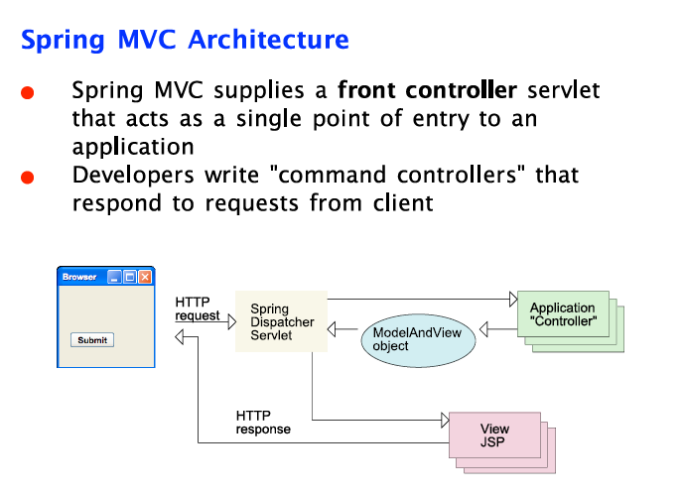

Slide 36

Lab 7 Couchbase Server
Please Fill Out Evaluations!
GotCha’s
Part 1
_2. Couchbase installation executable is in {springclass}\couchbase
Notes:
DeBrief:

Slide 37
Day 3: What Have We Learned?
Spring Core Review
What is the Spring Framework?
Spring Architecture
Introduction to REST
What is Representational State Transfer?
Principles of REST
Introduction to Java REST frameworks
RESTful CRUD Services
Create
Retrieve
Update
Delete
Spring and REST
Spring Support for REST
Message Converters
Annotations
Introduction to Spring Boot
What is Spring Boot?
Starter Projects
Autoconfiguration
Building and Running
Additional Spring Boot Topics
Starter Dependencies
Auto Configuration
Deploying a WAR
Spring Remoting and JMS
JmsTemplate
Sending and Receiving Messages
Introduction to Spring Batch
Batch Application Concepts
Spring Batch Concepts
Writing and Configuring a
Spring Batch Application

Slide 38
What Have We Learned?
Spring Core Review
What is the Spring Framework?
Spring Architecture
Introduction to REST
What is Representational State Transfer?
Principles of REST
Introduction to Java REST frameworks
RESTful CRUD Services
Create
Retrieve
Update
Delete
Spring and REST
Spring Support for REST
Message Converters
Annotations
Introduction to Spring Boot
What is Spring Boot?
Starter Projects
Autoconfiguration
Building and Running
Additional Spring Boot Topics
Starter Dependencies
Auto Configuration
Deploying a WAR
Spring Remoting and JMS
JmsTemplate
Sending and Receiving Messages
Introduction to Spring Batch
Batch Application Concepts
Spring Batch Concepts
Writing and Configuring a
Spring Batch Application
Introduction to Hadoop
HDFS
MapReduce
YARN
Introduction to NoSql and Couchbase
What is NoSql
Introduction to Couchbase Server
Couchbase in Java and Spring

